Slide 1
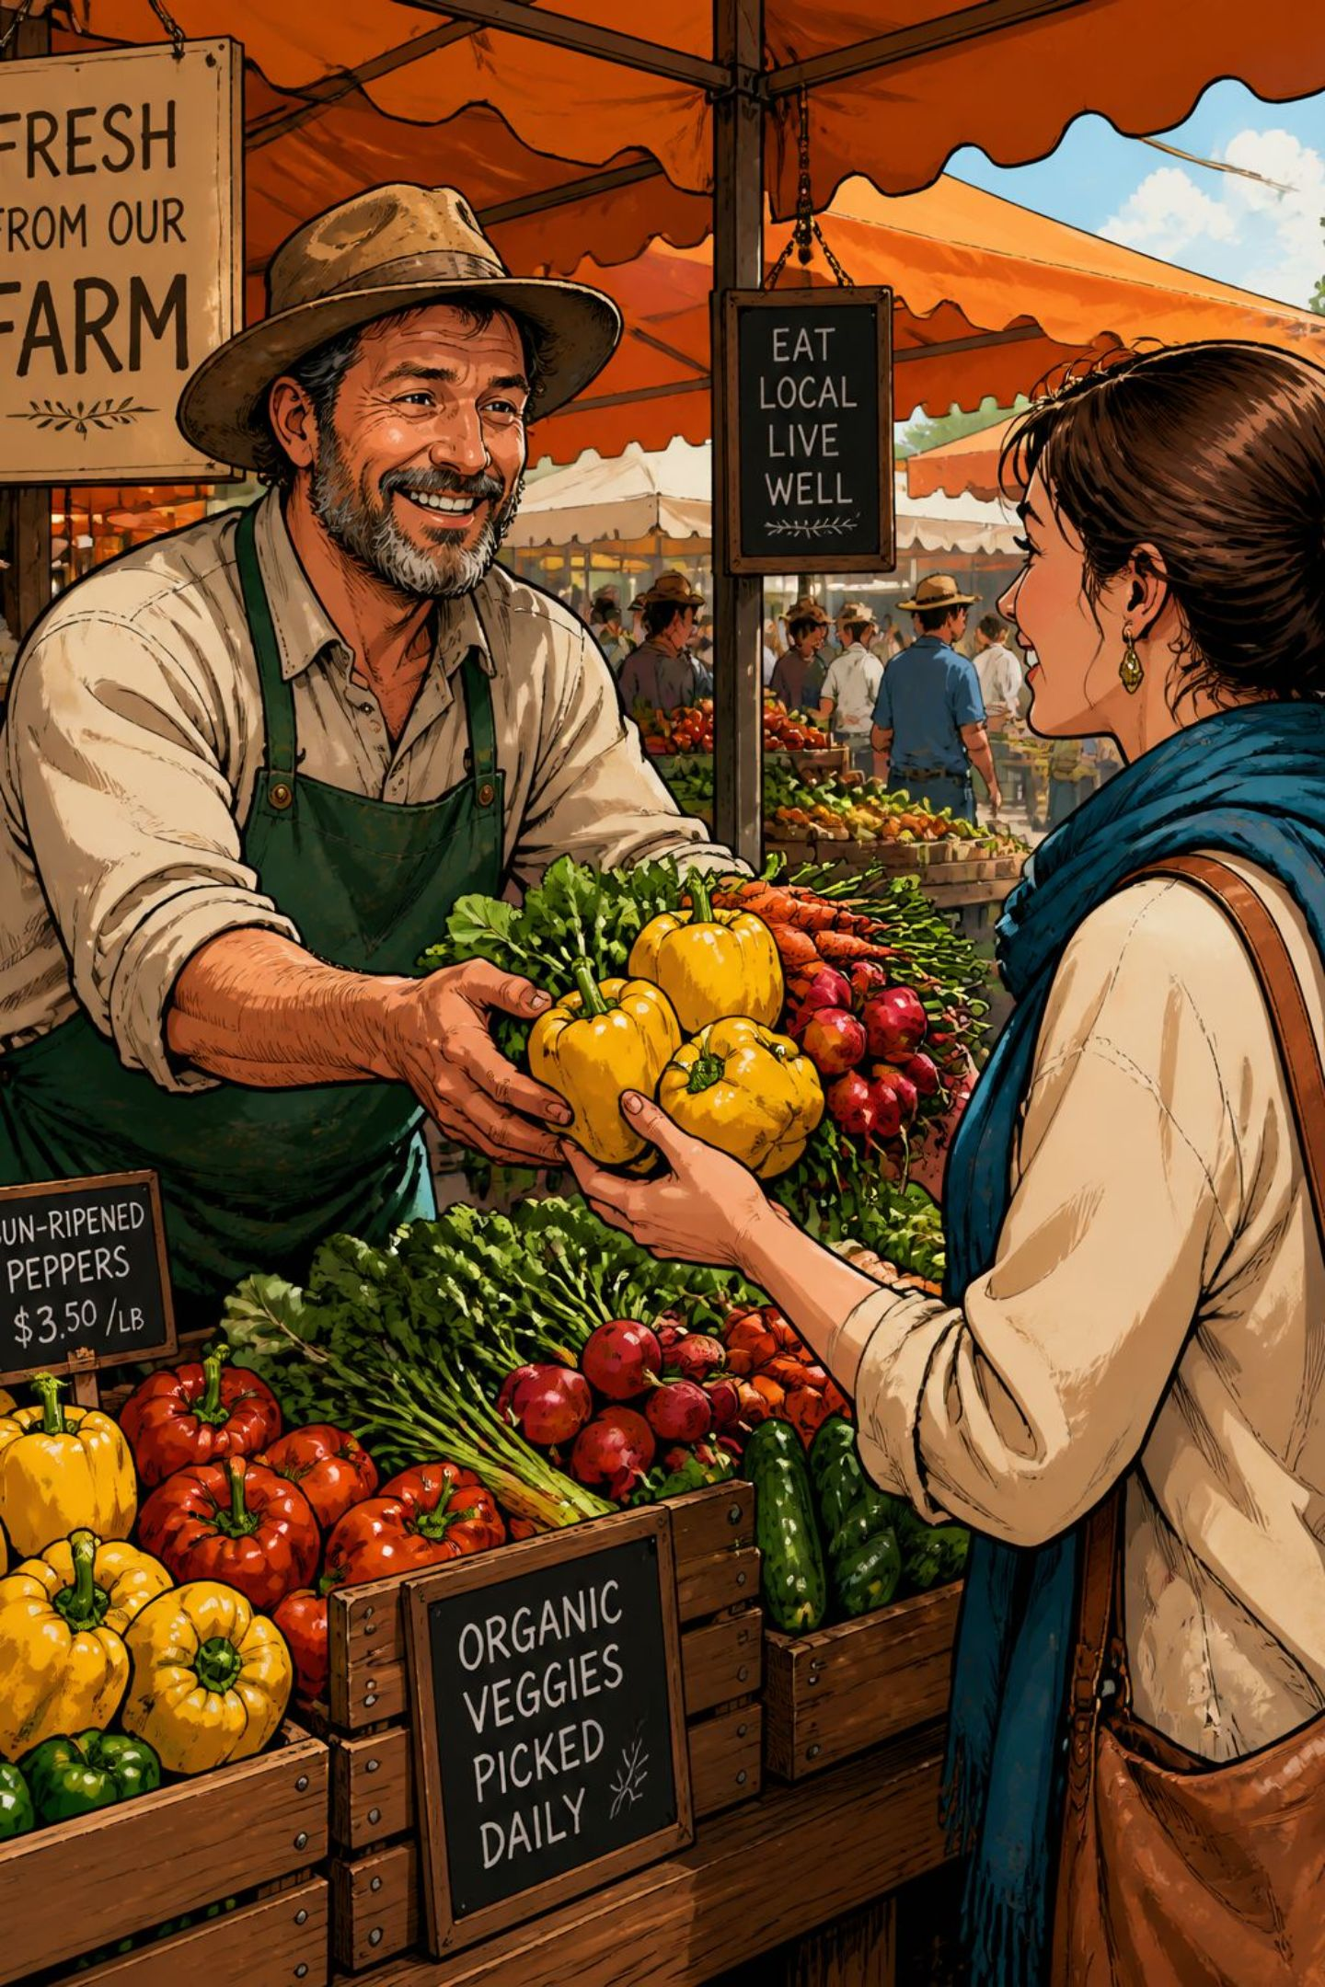
Price Transparency Framework for Farmer-to-Customer Food System
A framework for fair, clear, and trustworthy direct farm-to-customer food delivery.

Slide 2

Problem Statement
Farmer-to-customer food delivery platforms are designed to connect farmers directly with customers and help both sides benefit from the sale. However, in many cases, customers have to pay additional charges such as platform fees, packaging costs, delivery charges, and service fees. At the same time, farmers may receive only a small part of the total amount paid by the customer.
The main problem is that the complete flow of money is not clearly shown. Customers may not know how much of their payment actually reaches the farmer, while farmers may not know how the final selling price is divided. This lack of transparency can create confusion and reduce trust in direct farm-to-customer platforms.
There is a need for a simple and transparent pricing system that clearly shows how the customer's payment is distributed among the farmer, delivery, packaging, and platform — building trust for all parties.

Slide 3
Abstract
The Price Transparency Framework for Farmer-to-Customer Food Systems aims to create a fair, clear, and trustworthy connection between farmers and customers. In traditional food supply systems, several intermediaries may be involved, which can increase the price paid by customers while reducing the amount received by farmers. Even in online delivery platforms, customers may face hidden charges such as delivery, packaging, service, and platform fees.
The proposed framework focuses on making the pricing process easy to understand. When a customer purchases a product, the system can clearly show the total price and how it is divided between the farmer, delivery, packaging, and platform charges. This helps customers understand where their money goes and helps farmers know how much they earn from each sale.
The system can also provide digital traceability, allowing customers to know the source of the product and track its delivery. A dashboard can be used to monitor transactions, prices, and farmer earnings. Compliance checks can help identify incorrect or unfair charges, while smart logistics can help reduce delivery costs and food wastage.
Overall, the framework aims to improve farmer income, provide customers with clear pricing information, and build trust through transparency and fair value sharing. It can support a more sustainable and efficient farmer-to-customer food delivery system where both farmers and consumers benefit.

Slide 4
Existing Farmer-to-Customer Model
Existing farmer-to-customer food delivery models mainly focus on connecting farmers directly with customers through online marketplaces or delivery platforms. Farmers list their products, customers place orders, and the platform manages payments, packaging, delivery, and other services. Traditional food supply chains also involve intermediaries such as wholesalers, distributors, and retailers before products reach customers. Even in direct-to-customer platforms, the customer's payment may be divided among the farmer, platform, delivery, packaging, and service charges. Our existing framework identifies the need to make this complete flow easier to understand for both farmers and customers.

Slide 5
Drawbacks
The major drawback is the lack of complete price and payment transparency. Customers may see the final product price but may not clearly know how much of their payment actually reaches the farmer or how much is spent on delivery, packaging, platform, and service charges. Similarly, farmers may not have a clear view of how their product's final selling price is calculated. Traditional supply chains can also involve multiple intermediaries, which may increase the customer's price while reducing the farmer's share. These issues can create confusion, reduce trust, and make it difficult for both farmers and customers to determine whether the transaction is fair.

Slide 6
Proposed Improved Model
The proposed model can overcome these drawbacks by introducing a Price Transparency and Fair Distribution System. For every transaction, the platform can clearly display how the customer's total payment is divided among the farmer, delivery, packaging, platform, and other applicable charges. It can provide farmers with an earnings dashboard, customers with a "Where did my money go?" breakdown, and digital traceability to show the product's journey from farm to customer. The system can also use AI-based checks to identify unusual or unfair charges and smart logistics to reduce delivery costs and food wastage. This creates a more transparent, trustworthy, and fair farmer-to-customer system where both farmers and customers can clearly understand the value distribution.

Slide 7
AI & Development Tools Used in the Project
ChatGPT / Gemini Notebook → Generate project requirements, features, and use cases.
Jira → Generate user stories, tasks, and sprint plans for Farmer, Customer, and Admin modules.
Lucidchart AI → Generate the SOA/Microservices architecture diagram for Product, Order, Payment, Price Transparency, and Delivery services.
GitHub Copilot → Generate Spring Boot code, REST APIs, entities, services, and repositories.
Postman Agent Mode → Generate API requests and test cases for products, orders, pricing, and users.
Semgrep → Generate security analysis for the Spring Boot microservices and identify vulnerabilities.
GitHub Copilot → Generate JUnit unit tests for price calculation, orders, products, and other services.
GitHub Actions → Generate CI/CD workflow to automatically build, test, and security-check the project.

Slide 8
Thank You

